Slide 1


Stock(nvda) Prediction Using Machine Learning
Mahesh

Slide 2
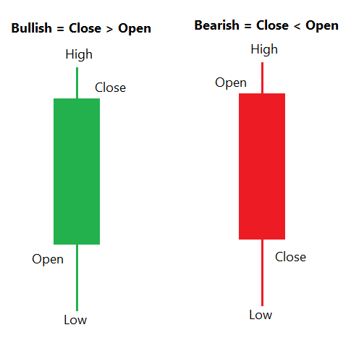
The Basics Of A Candlestick

Slide 3
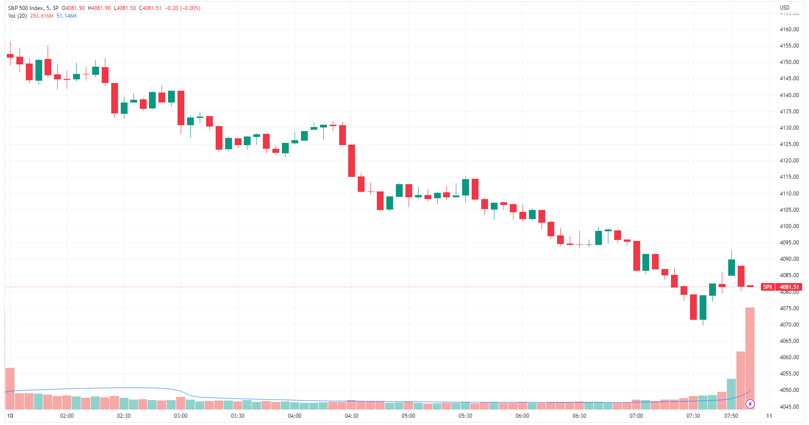
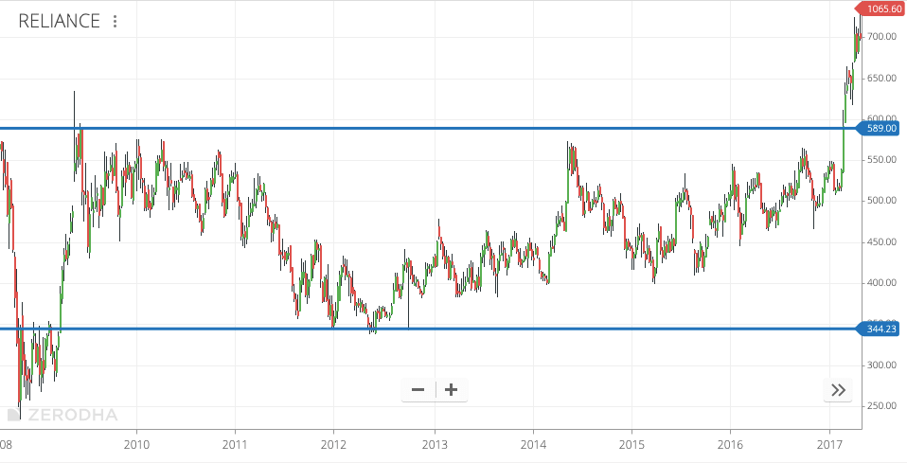
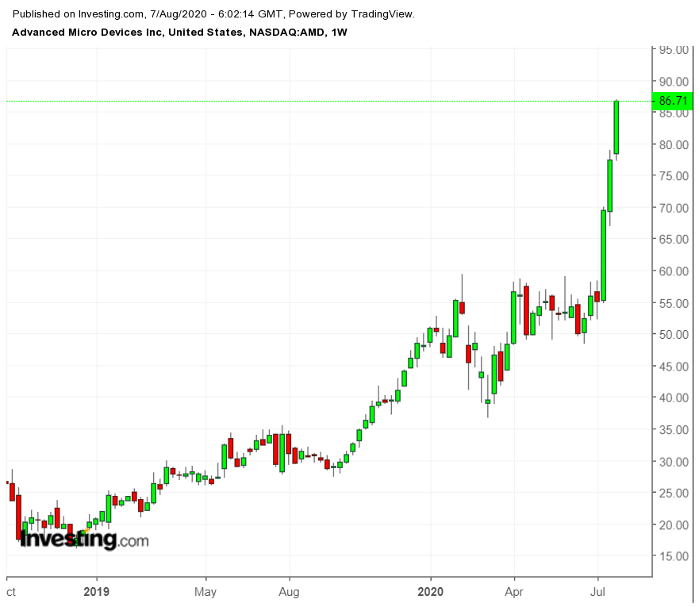
Stock market form of Ways
Downside Form
Sideway Form
Upside Form

Slide 4

Introduction to Stock Prediction with Machine Learning
Stock prediction using machine learning is a valuable tool for investors.
NVIDIA's stock (NVDA) is particularly popular for analysis due to its volatility.
Random Forest classifier is a common algorithm used for stock prediction.

Slide 5

Understanding Random Forest Classifier
Random Forest is an ensemble method that constructs multiple decision trees during training.
It is effective at handling high-dimensional data and capturing complex relationships.
The algorithm randomly selects subsets of features to build each tree, reducing overfitting.

Slide 6

Accuracy of 55.5% with Random Forest Classifier
A 55.5% accuracy rate with the Random Forest classifier indicates a moderate level of predictive power.
This accuracy can be improved by tuning hyperparameters and optimizing the model.
Additional techniques like feature engineering and data preprocessing can also enhance accuracy.

Slide 7

Introduction to AdaBoost
AdaBoost, short for Adaptive Boosting, is a boosting algorithm used to improve the performance of weak learners.
It focuses on instances that are misclassified by previous classifiers, giving them more weight.
By combining multiple weak learners, AdaBoost creates a strong classifier with high accuracy.

Slide 8

Tuning AdaBoost for Stock Prediction
AdaBoost can be fine-tuned by adjusting hyperparameters such as the learning rate and number of estimators.
Cross-validation techniques can help optimize the model's performance on unseen data.
Feature selection and ensemble methods can further enhance the predictive power of AdaBoost.

Slide 9
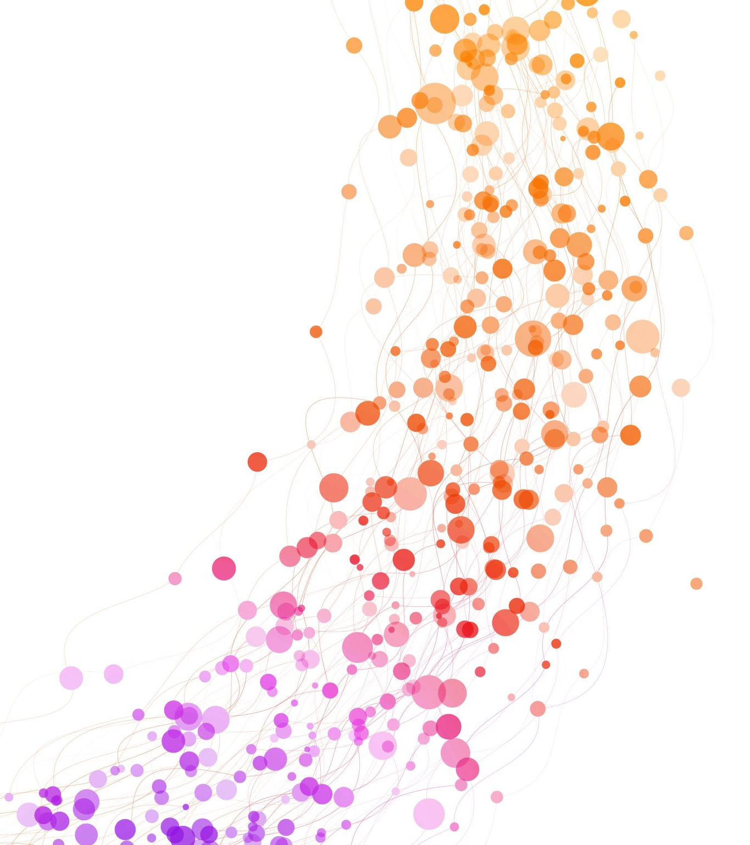
Leveraging AdaBoost for NVDA Stock Prediction
Applying AdaBoost to NVIDIA's stock prediction can help improve accuracy beyond 55.5%.
The algorithm's ability to adapt and learn from misclassified instances can capture subtle market trends.
By combining AdaBoost with Random Forest, a more robust and accurate prediction model can be developed.

Slide 10

Evaluating Model Performance
Model performance can be assessed using metrics such as accuracy.
Monitoring the model's performance in real-time and adjusting parameters as needed is crucial for long-term success.

Slide 11
Risks and Considerations in Stock Prediction
Stock prediction models are subject to market volatility and unexpected events that may impact accuracy.
Overfitting and data leakage are common pitfalls in machine learning models that should be addressed.
Investors should use predictive models as one tool in their decision-making process, alongside fundamental and technical analysis.

Slide 12

Future Directions and Opportunities
Advancements in machine learning algorithms and data sources offer new opportunities for stock prediction.
Incorporating alternative data sources such as social media sentiment and satellite imagery can enhance predictive models.
Collaborations between domain experts, data scientists, and investors can drive innovation in the field of stock prediction.

Slide 13
Stock prediction using machine learning, particularly with Random Forest and AdaBoost, offers valuable insights for investors.
By fine-tuning algorithms and leveraging ensemble methods, accuracy rates can be improved beyond 55.5%.
Continuous monitoring, model refinement, and a comprehensive understanding of market dynamics are key to successful stock prediction.
Conclusion

Slide 14
on
Thank You

